Slide 1

JAYOTI VIDYAPEETH WOMEN’S UNIVERSITY, JAIPUR
Faculty of Civil in Engineering
A Review on Stone as a Building Material
Submitted by:
Neha Kotiya( jv-u/17/1629)

Slide 2
CONTENTS
INTRODUCTION
CLASSIFICATION OF STONES
CHARACTRISTICS OF STONES
QULITY TEST CONDUCTED ON STONE
USES OF STONE
CONCLUSION

Slide 3
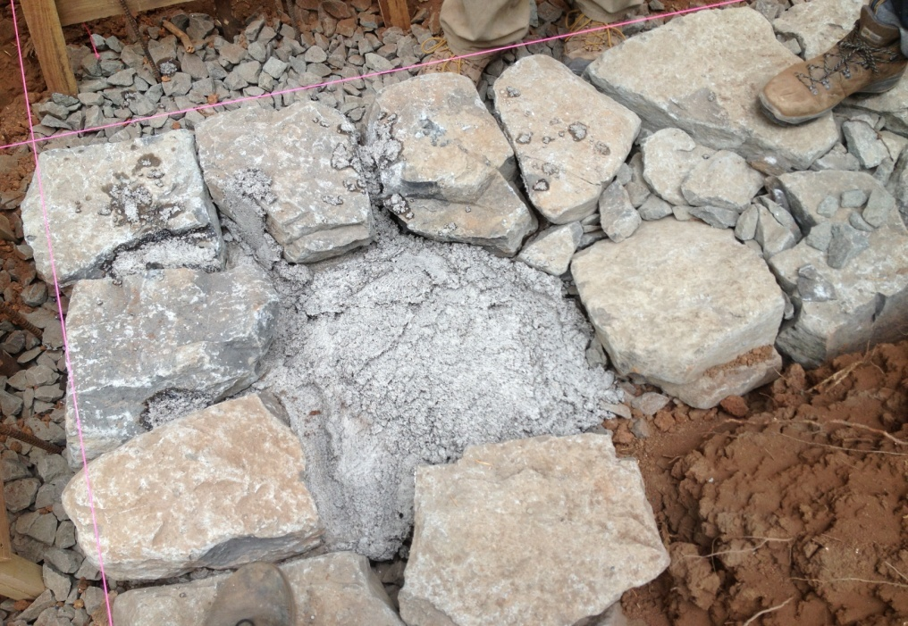
WHAT IS STONE?
The hard, solid, non metallic mineral matter of which rock is made, a building material.
SOURCES OF STONE-
Monomineralic rock
polymineralic rock

Slide 4
STONE-AS A BUILDING MATERIAL
Stone have been considered as one of the popular building material from the olden days due to their availability in abudance from the natural rocks.
Building stones should posses enough strength and durability.
The stone which are suitable for the construction of the
Structures such as a retaining walls , abutments, dams,
Barrages, roads etc. are known as building stones.

Slide 5
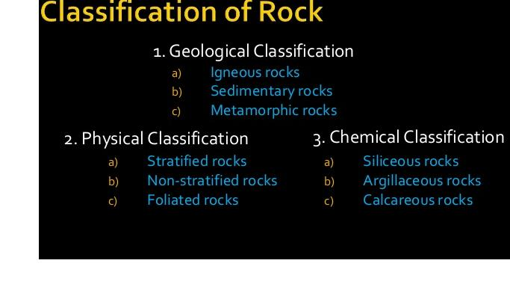

Slide 6
CHARACTERISCTIS OF STONE
HARDNESS
DURABILITY
DECOMPOSITION
WEIGHT
STRENGTH
APPERANCE AND COLOUR
SEASONING QUALITY
FIRE RESISTANCE
SPECIFIC GRAVITY

Slide 7
QUALITY TESTS CONDUCTED ON STONES
CRUSHING STRENGTH TEST
WATER ABSORPTION TEST
ABRASION TEST
IMPACT TEST
ACID TST

Slide 8
USES OF STONE
Stone masonry is used for the development of foundations, walls, columns and arches.
Stones are used for floors.
Stone slabs are used as damp evidence courses, lintels and at the same time as roofing substances.
Stones with proper look are used for the face works of homes. Polished marbles and granite are usually used for face works.
Stones are used for paving of roads, footpaths and open spaces round the buildings.

Slide 9
CONCLUSION
The dimension, constructing, and decorative stone industries these days are nearly non-existent due to opposition from different, decrease cost materials. New creation technology, together with a less labor-intensive economy and modern architectural leanings has reduced the demand for stone.
Throughout history, natural stone has been the premier building material all over the world. Natural stone makes homes more sophisticated and elegant. People perceive it to be high quality and to have high value.

Slide 10
THANK YOU

